Slide 1
Lecture 7b Solving Recurrence Relations 2

Slide 2
Recall: Solving a Recurrence Relation
2
Solving a recurrence relation – finding an explicit formula that defines the same sequence
Solution to a recurrence relation not always exists
We will study 5 methods for solving recurrence relations

Slide 3
Five Methods
3
Guess + Prove by Induction
Telescoping a Sum
Substituting
Solving homogeneous/inhomogeneous recurrence relations
Master Method
only the order obtained, not the precise formula (technically not solution)

Slide 4
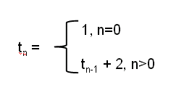
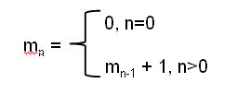
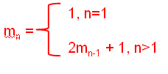
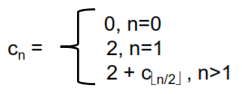

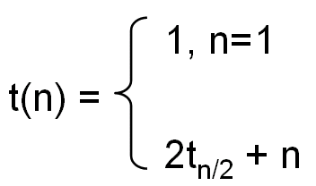
Substitution
Factorial (multiplications, time)
Hanoi
Binary search
Max subsequence sum algorithm 3
1
4

Slide 5
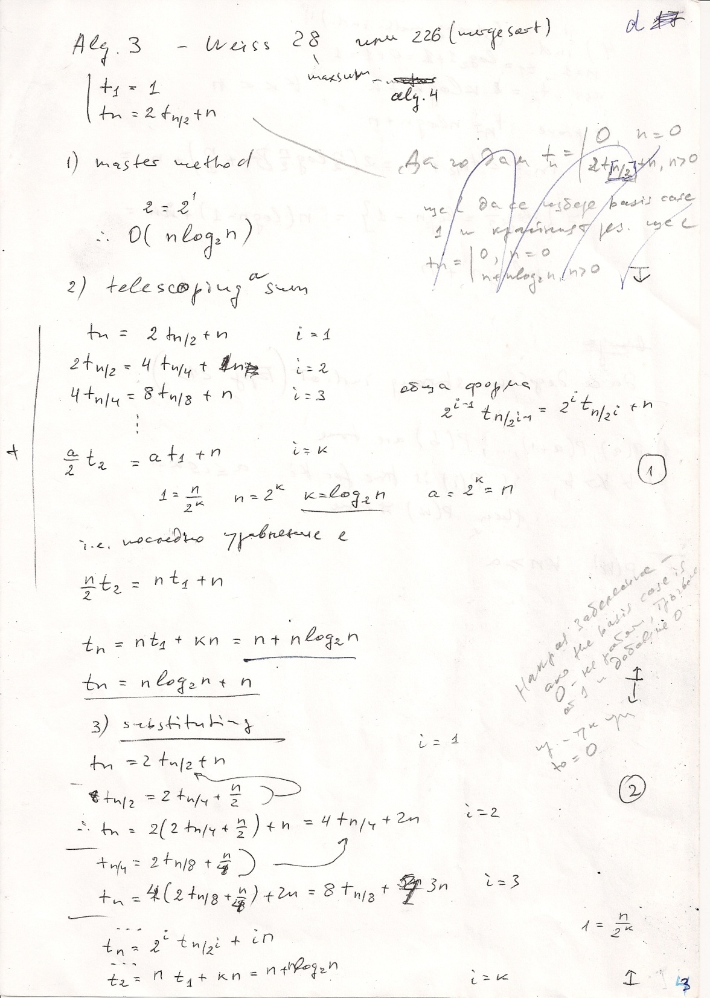

Max subsequence sum
5

Slide 6
Solving Homogeneous Recurrence Relations
a_{o}t_{n}+a₁t_{n-1}+…+a_{k}t_{n-k} = 0
+ k initial conditions, usually 0≤i≤k-1 or 1≤i≤k
Write characteristic polynomial
p(x) = a₀x^{k}+a₁x^{k-1}+…+a_{k-2}x²+a_{k-1}x+a_{k}
Find roots of characteristic polynomial r₁,…, r_{k}
General form of solution t_{n} = c₁r₁^{n}+c₂r₂^{n}+…+c_{k}r_{k}^{n}
Find all c_{i} from n initial conditions
6

Slide 7
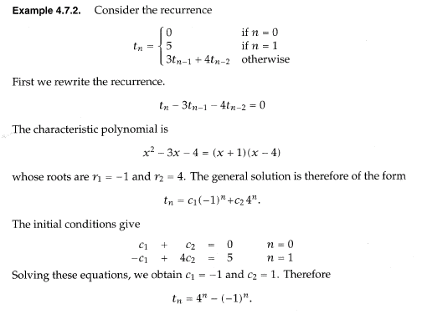
Example
1

Slide 8
Example

Slide 9
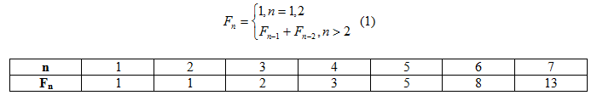
Example: Fibonacci numbers
Sometimes we will start from 0 (easier calculations)
n | 0 | 1 | 2 | 3 | 4 | 5 | 6 | 7
F_{n} | 0 | 1 | 1 | 2 | 3 | 5 | 8 | 13
0, n=0
Fn = 1, n=1
Fn-1+Fn-2, n>1
2
9

Slide 10
Example: Fibonacci numbers

Slide 11
Example: Fibonacci numbers

Slide 12
Solving Homogeneous Recurrence Relations
3
n, n=0,1,2
tn =
5t_{n-1}-8t_{n-2}+4t_{n-3}, n>1
(x-1)(x-2)²=0
t_{n}=c₁1^{n}+c₂2^{n}+c₃n2^{n}
12
With single roots
With multiple roots
t_{n} = … c’r^{n} + c’’nr^{n} + c’’’n²r^{n} +…

Slide 13
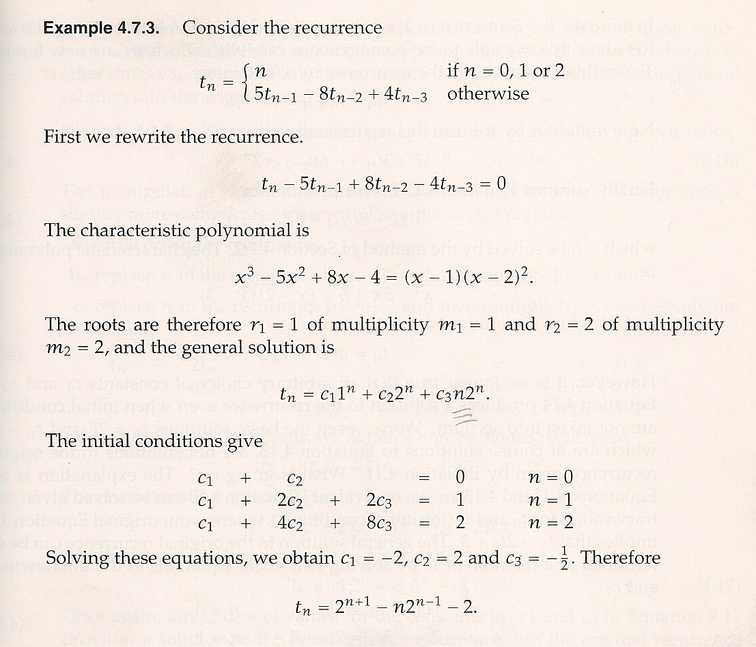
Multiple roots
13

